Slide 1
Intelligence Business Solutions Vietnam
- Communication training –
(Hi context and low context)
6th March 2015
Công Ty TNHH Giải Pháp Kinh Doanh Intelligence Việt Nam

Slide 2
Contents
Hi context and low context
Difference between hi context and low context
Global society is ultimate low context world
Summary

Slide 3
1. Hi context and low context
What is the context?

Slide 4
1. Hi context and low context
Context means…
Language, common knowledge,
experience, logic, sense of value, and
tastes.
→These are the base of communication.

Slide 5
1. Hi context and low context
What is hi context?

Slide 6
1. Hi context and low context
Hi context means high share ratio of context.
In this case, it’s easy to communicate without effort and skills. Especially Japan, this tendency is strong.

Slide 7
1. Hi context and low context
In Japan, they Japanese prefer this culture.
However, when they communicate with foreigners, they can’t communicate smoothly.

Slide 8
1. Hi context and low context
What is low context?

Slide 9
1. Hi context and low context
Low context means low share ratio of context.
In this case, language is the most important thing to communicate. Especially Europian and American, this tendency is strong.

Slide 10
1. Hi context and low context
Therefore, they Europian and American think that language is variable and efficient to communicate.
In this case, we need to improve logical thought, expressiveness, explanation ability, negotiation ability, and debate ability.

Slide 11
2. Difference between hi context and low context
What is the difference between hi context culture and low context culture?

Slide 12
2. Difference between hi context and low context
<Hi context culture>
Everyone will expect listener’s ability.
They prefer simple expressions or complex depiction to direct expressions.
In addition, they don’t emphasize questions and answers is important.

Slide 13
2. Difference between hi context and low context
<Low context culture>
Everyone thinks that speaker is important.
They like simple and easy and clear expressions.
They don’t like leap in logic.
They like simple logic.

Slide 14

2. Difference between hi context and low context
This is an example.
In hi context culture…
A: “How was your business talk with the client yesterday?”
B: “So so. I did my best. It’s ok.”

Slide 15

2. Difference between hi context and low context
In low context culture…
A: “How was your business talk with the client yesterday?”
B: “It was so successful. I got two new big contracts there”
Did you understand the difference?

Slide 16

3. Global society is ultimate low context world
What should we do in the global society?
Each people has each sense of value, experience, knowledge, moral values, outlook on life, and religion.
It’s difficult to communicate each other with hi context culture.

Slide 17
4. Summary
The numbers of foreigners is increasing in Japan(Vietnam).
In addition, Japanese(Vietnamese) people’s sense of value is diversifying nowadays.
It means people in hi context culture must be changed into low context culture.

Slide 18
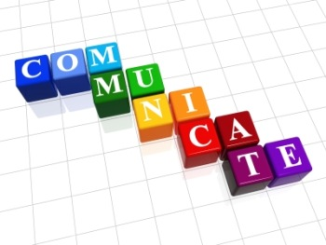
5. Message
Don’t hesitate to confirm the purpose and work contents to Japanese members.
If you can’t understand it clearly, you need to continue to communicate with them.
In addition, you need to improve your communication skills.

Slide 19
Thanks for your attention.

